Slide 1

Free GCSE maths worksheets, every grade
215 topics from grade 1 to grade 9, with every answer worked out by hand. No account, no sign-up, nothing to pay. KS3 and A-level too.
robinsontuition.com/gcse-maths-topics
Notes:
Show this at the start of a lesson or in form time. It takes about three minutes.

Slide 2
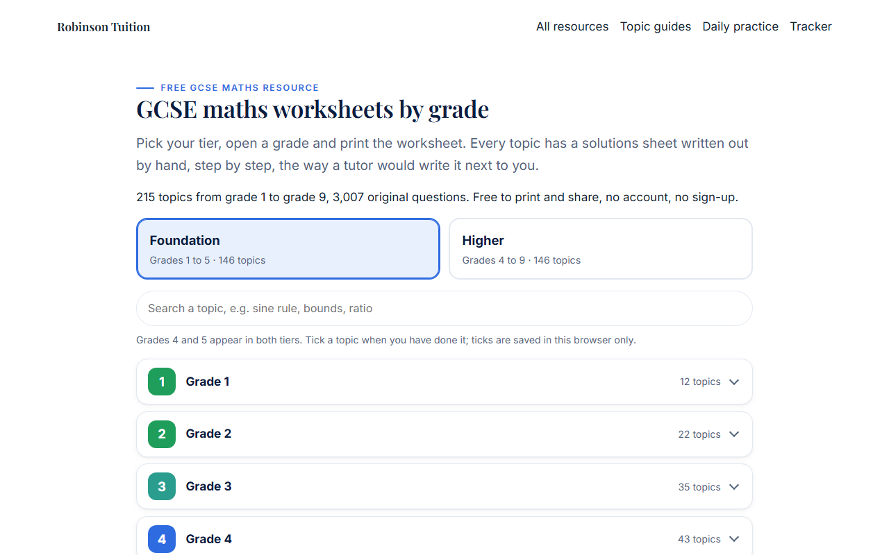
What it is
1
215 topics
One worksheet per topic, grade 1 to grade 9.
2
Three sheets each
Worksheet, answers, and full hand-written solutions.
3
Pick your tier
Foundation shows grades 1 to 5, Higher shows 4 to 9.

Slide 3
How to use it
1
2
3
4
Choose a topic
Do the worksheet
Mark it
Learn from solutions
Pick the grade you are working at and open a topic you find hard, not one you already know.
Print it or do it on paper from the screen. Write your working: the method is the mark.
Use the answers sheet. Tick what is right, circle what is wrong.
For every wrong one, read the hand-written solution and find the line where yours went different.

Slide 4
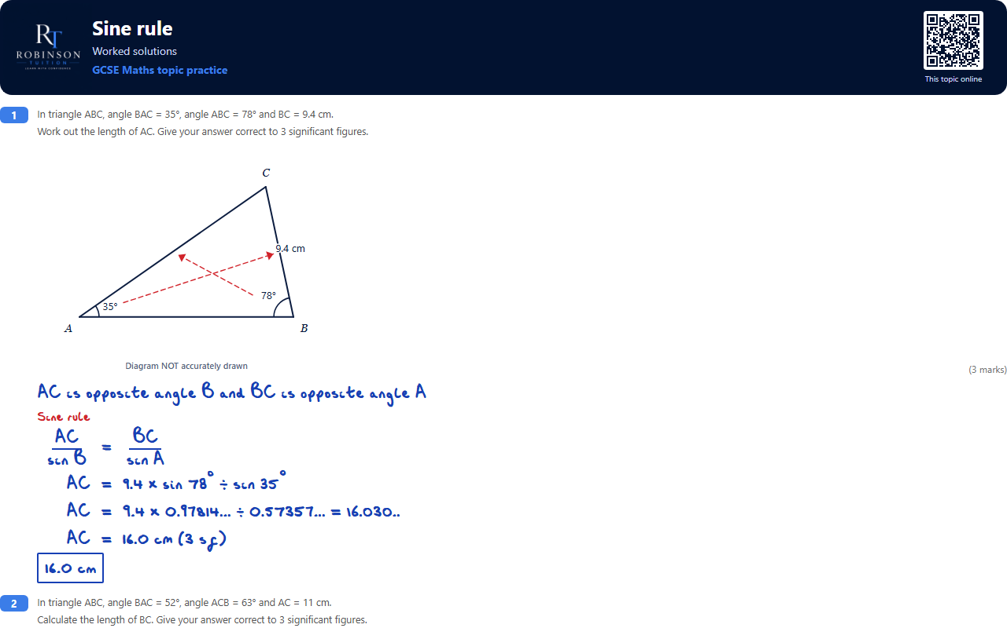
Every step, written by hand
The solutions look like a tutor wrote them next to you.
Blue is the working. Red is the method and the operation on each line.
The answer is boxed, the way the examiner wants to see it.
Cover the working, try the question, then compare line by line.

Slide 5
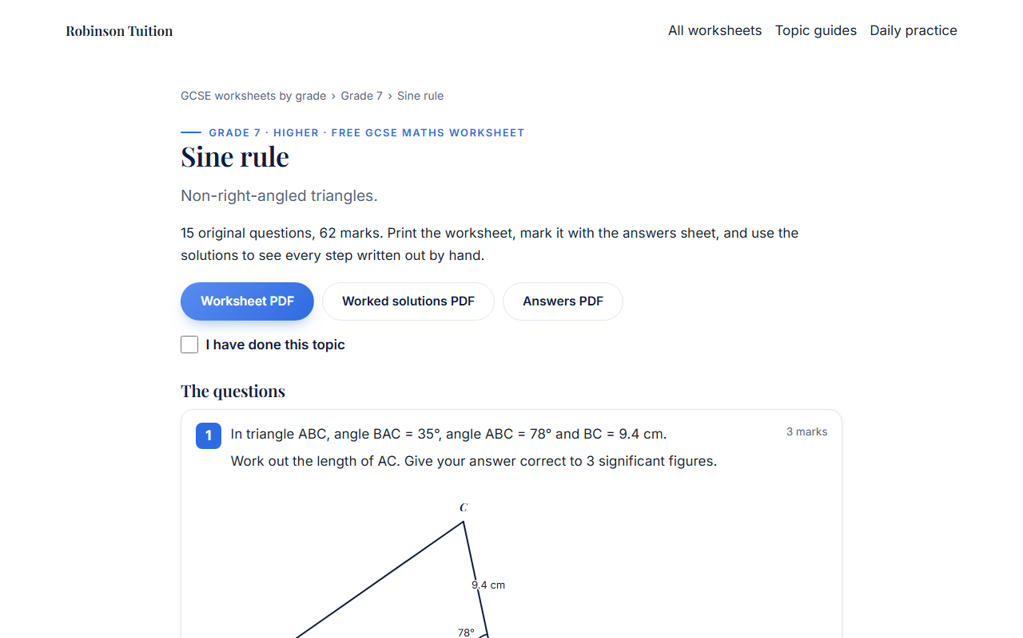
One topic a week is enough
âœ“
Tick it off
Each topic has a tick box. Your ticks are saved on your phone or laptop.
âœ“
Watch the grade fill up
The grade heading shows how many topics you have done.
âœ“
Scan the sheet
Every printed sheet has a QR code that takes you straight back to that topic.

Slide 6
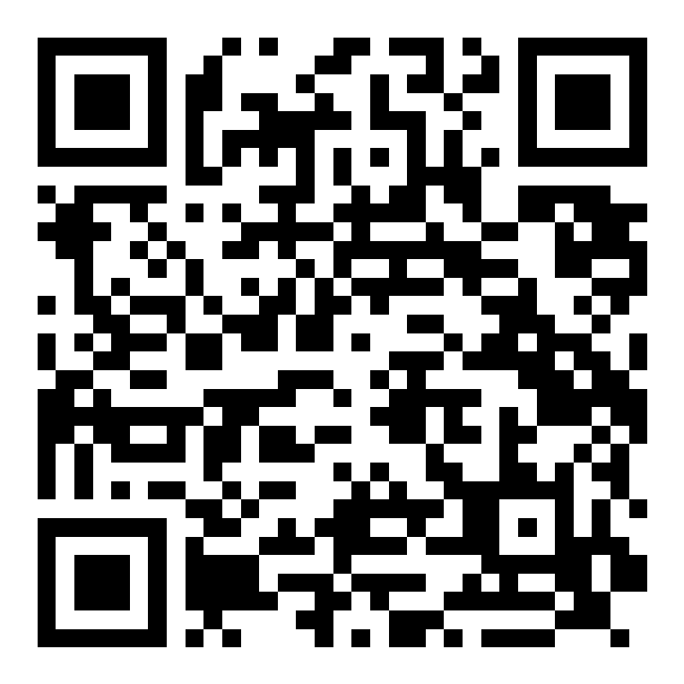
Years 7 to 9: KS3 worksheets
What it is
How to use it
70 topics across Years 7, 8 and 9, in the order a school teaches them.
Worksheet, answers sheet and full hand-written solutions for every topic.
Free, no account, no sign-up.
Open your year and pick the topic you are doing in class.
Print the worksheet, or answer online for an instant score.
Mark it with the answers, then read the solutions for anything wrong.
80% or more ticks the topic off on your own device.
Scan the code or go to
robinsontuition.com/ks3-maths-topics
robinsontuition.com/ks3-maths-topics
Notes:
For Year 7 to 9 classes. The library follows a school scheme of learning, so the topics come in the order they are taught.

Slide 7
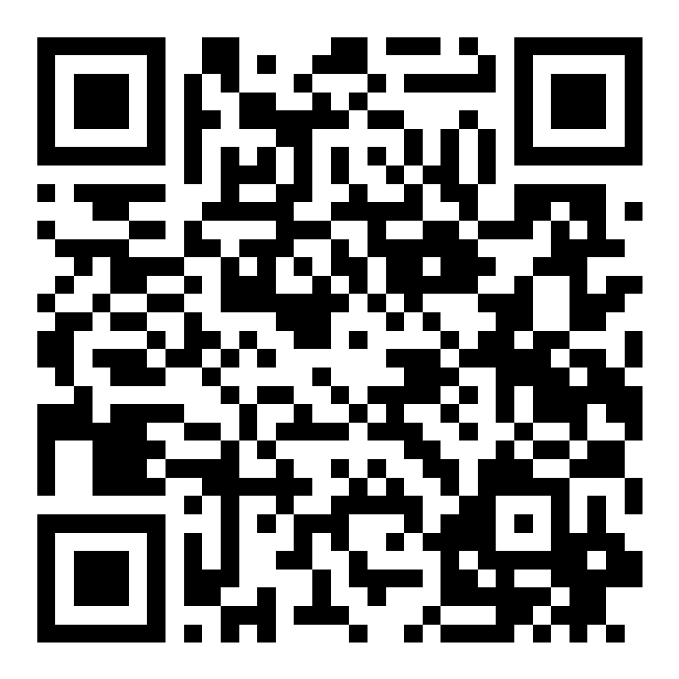
Sixth form: A-level worksheets
What it is
How to use it
57 topics across Pure, Statistics and Mechanics, AS and A2, for Edexcel.
Exam-style questions with full hand-written solutions, the way a tutor would write them.
Free, no account, no sign-up.
Open a unit (Pure, Statistics or Mechanics) and pick a topic.
Print the worksheet, or answer online for an instant score.
Mark it with the answers, then compare your working with the solutions line by line.
Tick off each topic and fill in your RAG sheet.
Scan the code or go to
robinsontuition.com/a-level-maths-topics
robinsontuition.com/a-level-maths-topics
Notes:
For Year 12 and 13. AS topics suit both years; the Year 2 units cover the rest of the full A-level.

Slide 8
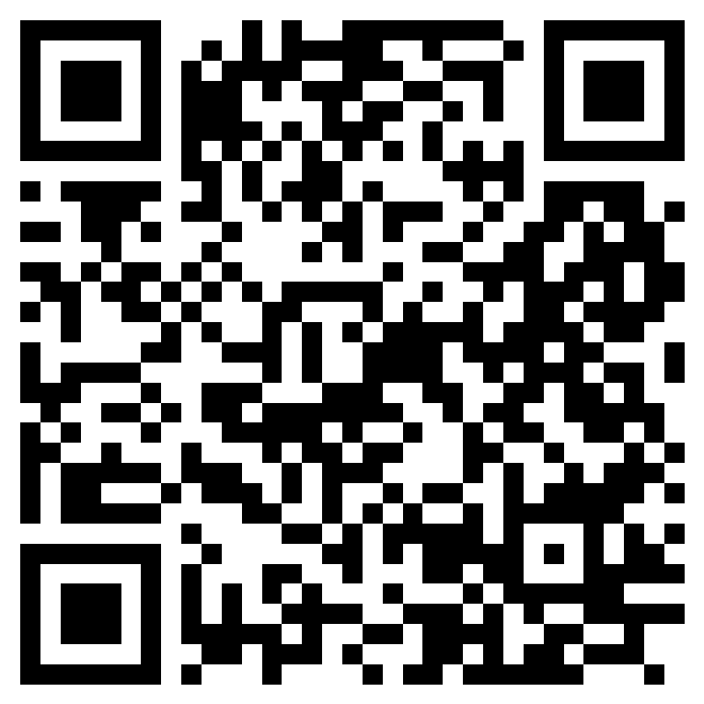
Scan the code
or type the address
robinsontuition.com/gcse-maths-topics
KS3: robinsontuition.com/ks3-maths-topics
A-level: robinsontuition.com/a-level-maths-topics
Free for students, parents and schools. Original questions by Robinson Tuition.
Notes:
Leave this slide up so students can scan it on their phones.

